Slide 1

BOX HILL ART SCHOOL APP
Copy the link below and paste it into your web browser's address bar to view the file in high-definition (HD) in Figma:
https://www.figma.com/file/IbvEyZrt3tBonq5hbhHZ9v/Mock-up?type=design&node-id=401%3A135682&t=15YE3Sd0kgpDdv2X-1

Slide 2
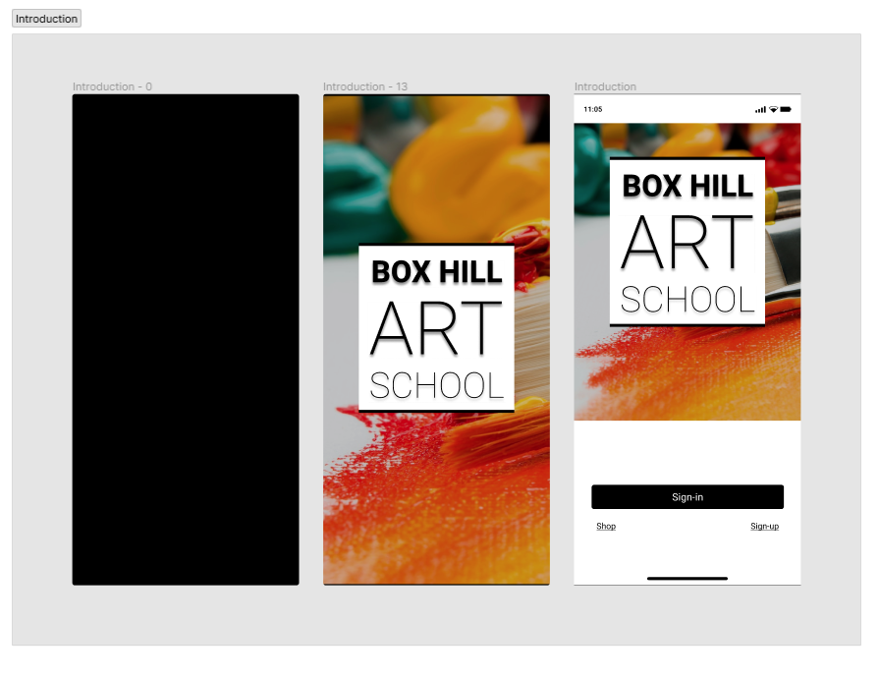
Introduction
Copy the link below and paste it into your web browser's address bar to view the file in high-definition (HD) in Figma:
https://www.figma.com/file/IbvEyZrt3tBonq5hbhHZ9v/Mock-up?type=design&node-id=401%3A135682&t=15YE3Sd0kgpDdv2X-1

Slide 3
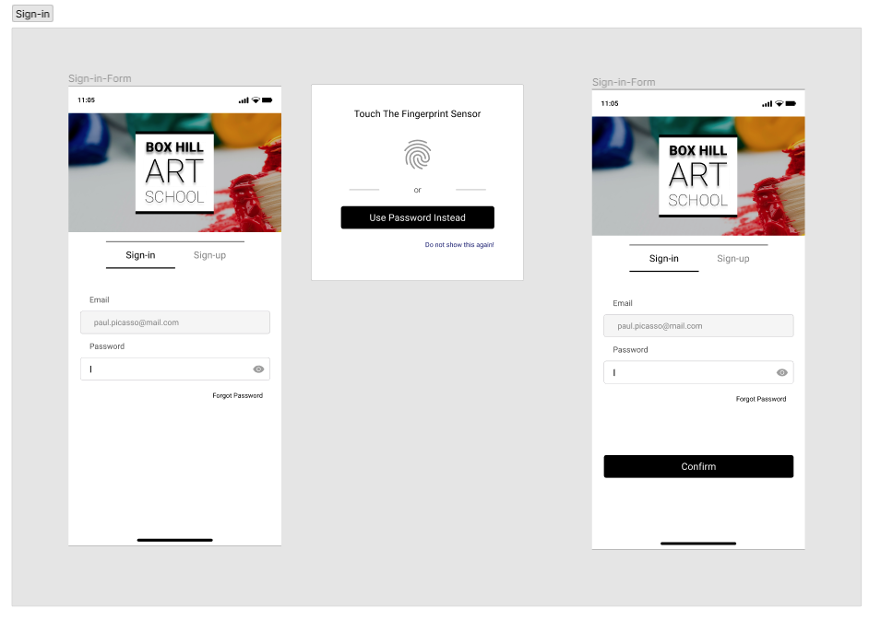
SIGN-IN
Copy the link below and paste it into your web browser's address bar to view the file in high-definition (HD) in Figma:
https://www.figma.com/file/IbvEyZrt3tBonq5hbhHZ9v/Mock-up?type=design&node-id=401%3A135682&t=15YE3Sd0kgpDdv2X-1

Slide 4
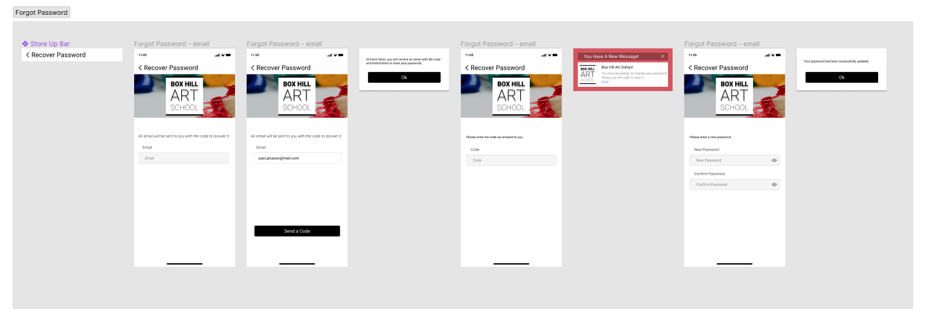
FORGOT PASSWORD
Copy the link below and paste it into your web browser's address bar to view the file in high-definition (HD) in Figma:
https://www.figma.com/file/IbvEyZrt3tBonq5hbhHZ9v/Mock-up?type=design&node-id=401%3A135682&t=15YE3Sd0kgpDdv2X-1

Slide 5
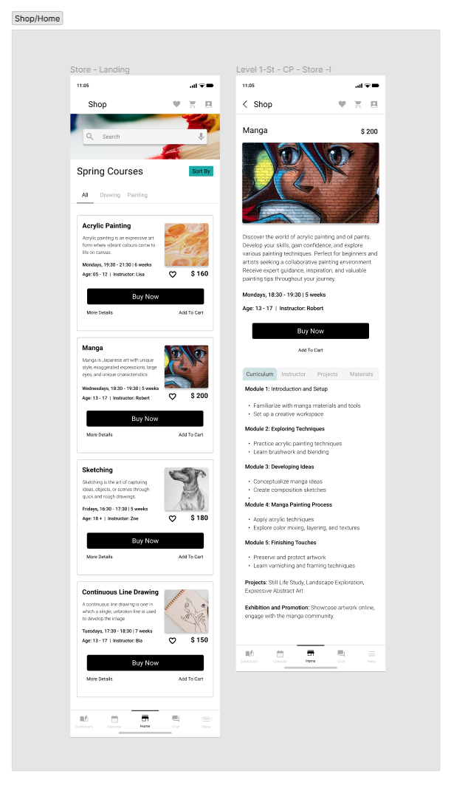
SHOP / HOME
Copy the link below and paste it into your web browser's address bar to view the file in high-definition (HD) in Figma:
https://www.figma.com/file/IbvEyZrt3tBonq5hbhHZ9v/Mock-up?type=design&node-id=401%3A135682&t=15YE3Sd0kgpDdv2X-1

Slide 6
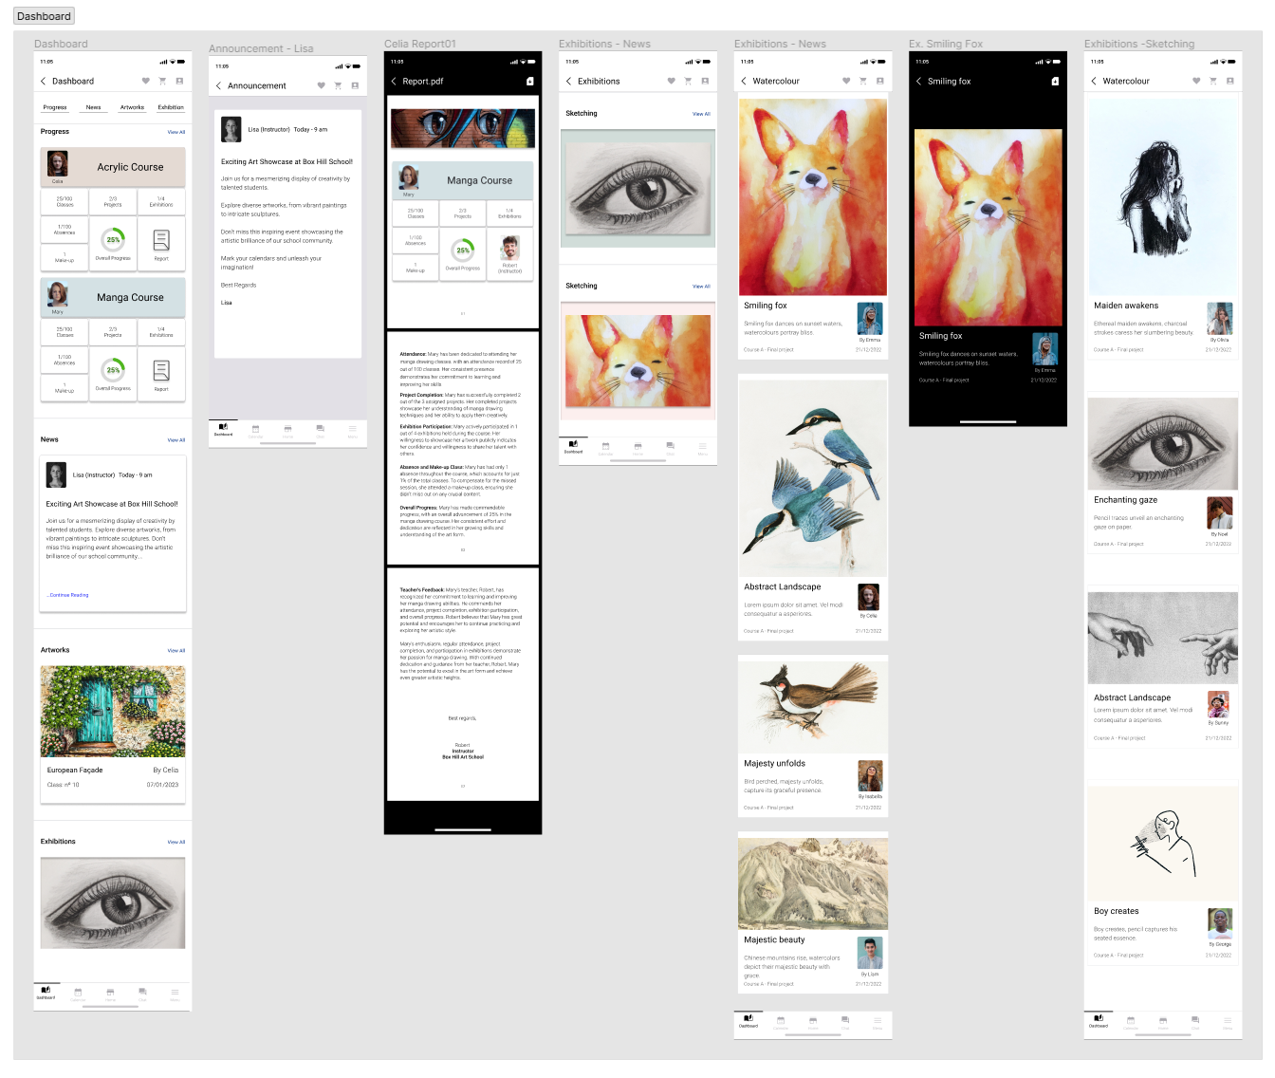
DASHBOARD
Copy the link below and paste it into your web browser's address bar to view the file in high-definition (HD) in Figma:
https://www.figma.com/file/IbvEyZrt3tBonq5hbhHZ9v/Mock-up?type=design&node-id=401%3A135682&t=15YE3Sd0kgpDdv2X-1

Slide 7
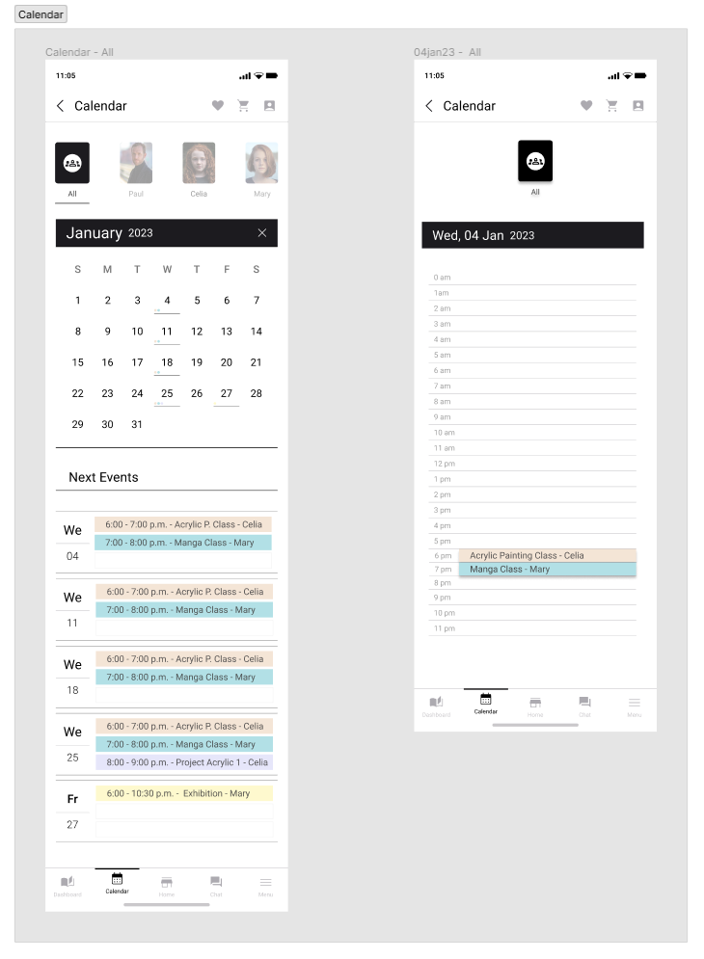
CALENDAR

Slide 8
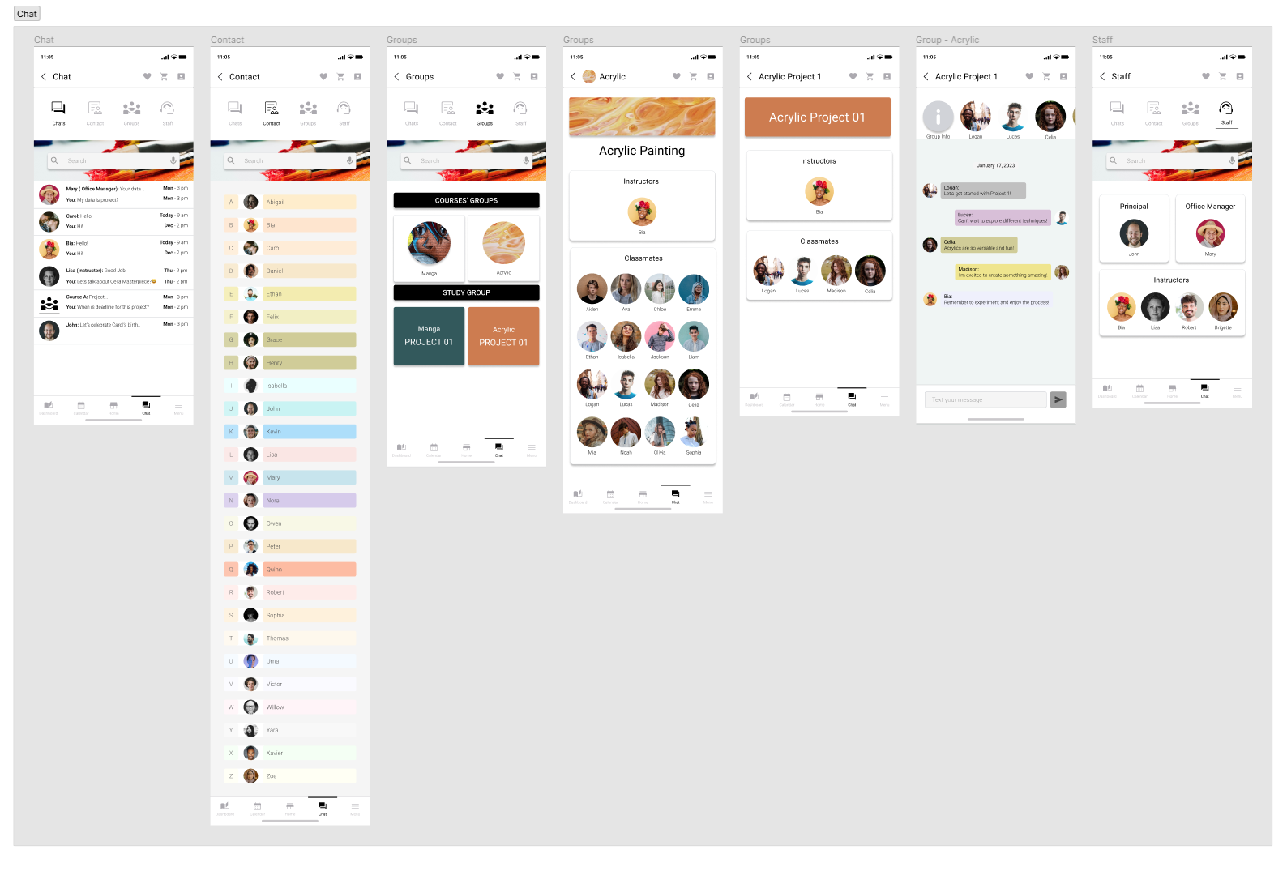
CHAT
Copy the link below and paste it into your web browser's address bar to view the file in high-definition (HD) in Figma:
https://www.figma.com/file/IbvEyZrt3tBonq5hbhHZ9v/Mock-up?type=design&node-id=401%3A135682&t=15YE3Sd0kgpDdv2X-1

Slide 9
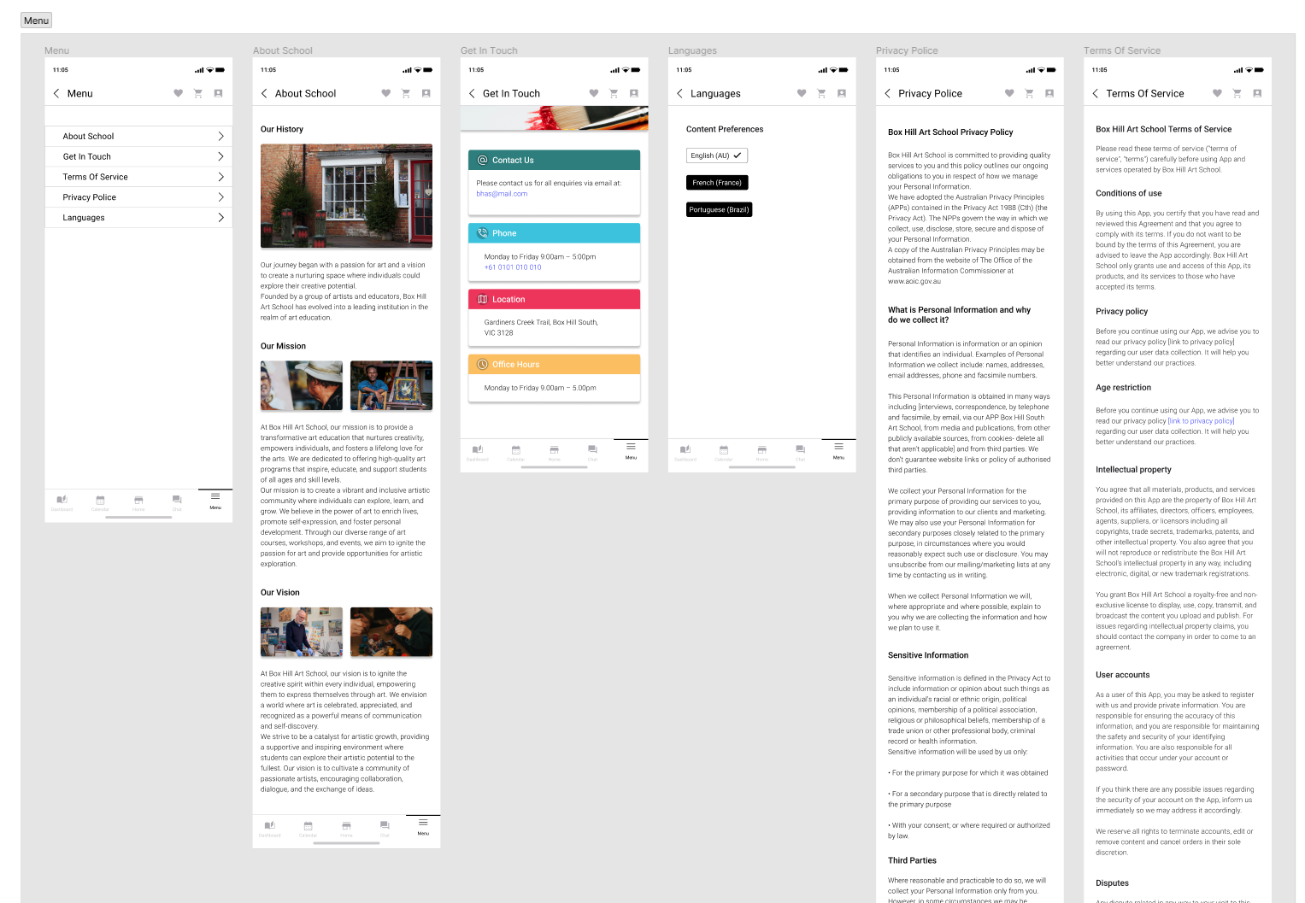
MENU
Copy the link below and paste it into your web browser's address bar to view the file in high-definition (HD) in Figma:
https://www.figma.com/file/IbvEyZrt3tBonq5hbhHZ9v/Mock-up?type=design&node-id=401%3A135682&t=15YE3Sd0kgpDdv2X-1

Slide 10
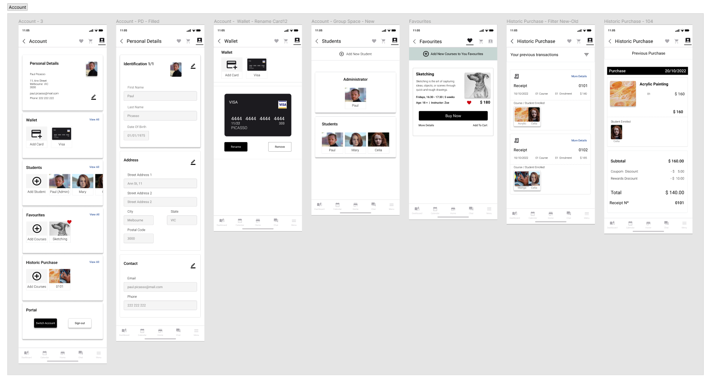
ACCOUNT
Copy the link below and paste it into your web browser's address bar to view the file in high-definition (HD) in Figma:
https://www.figma.com/file/IbvEyZrt3tBonq5hbhHZ9v/Mock-up?type=design&node-id=401%3A135682&t=15YE3Sd0kgpDdv2X-1

Slide 11
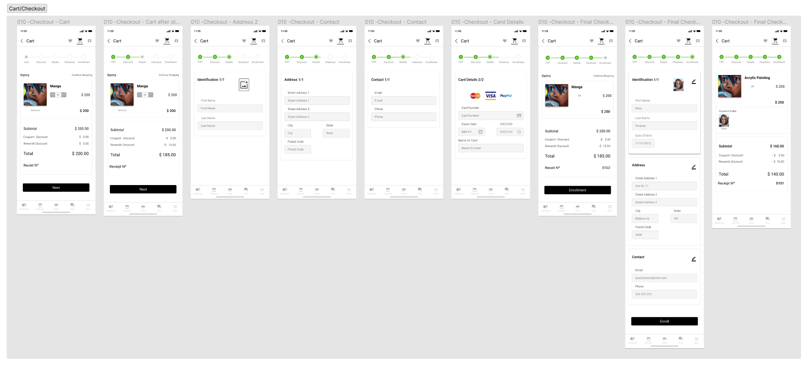
CART/CHECKOUT
Copy the link below and paste it into your web browser's address bar to view the file in high-definition (HD) in Figma:
https://www.figma.com/file/IbvEyZrt3tBonq5hbhHZ9v/Mock-up?type=design&node-id=401%3A135682&t=15YE3Sd0kgpDdv2X-1

Slide 12
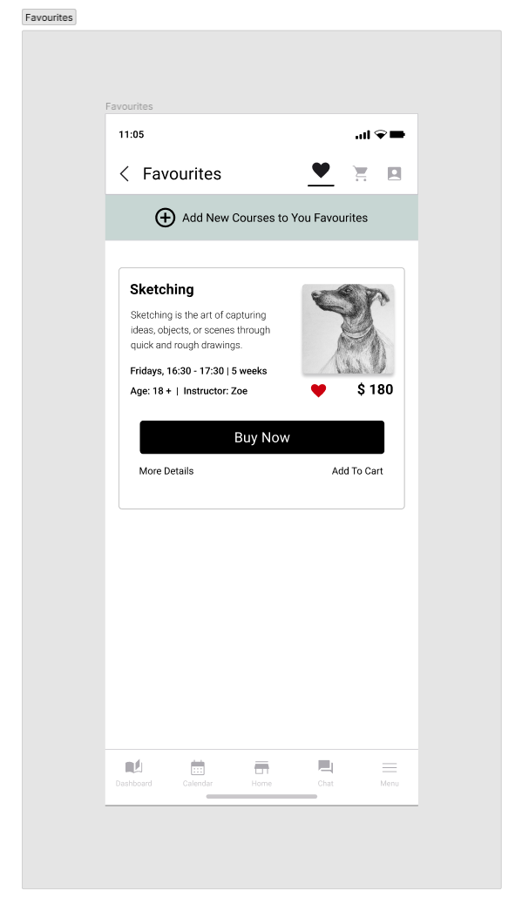
FAVOURITES
Copy the link below and paste it into your web browser's address bar to view the file in high-definition (HD) in Figma:
https://www.figma.com/file/IbvEyZrt3tBonq5hbhHZ9v/Mock-up?type=design&node-id=401%3A135682&t=15YE3Sd0kgpDdv2X-1

